Slide 1
Patient information system for st. louise de marillac

Slide 2
Members:
Alovera, Joven
Hare, Jho Anna
Jago, Angelica
Erigbuagas, Osayris

Slide 3
introduction statement of the problems objectives conceptual framework scope & limitations significance of the study methodology

Slide 4
Introduction
Patient Information System for St. Louise de Marillac helps the medical workers and the owner doing their task or duties much faster and easier every day or daily. This improves their workflow and service to their patients and to make their process of work more accurate, fast, easy, and keeping records, filtering records, easy to identify the records and secure the records, and also, including the records of payment transaction of every patient.

Slide 5
Statement of the Problems
Difficulty in retrieving /searching and erroneous recording of patient’s information that causes delays and inaccuracy of patient’s records;
Disorderly/disorganized accommodation of patients due to poor scheduling of appointments that causes limited accommodation of patients;

Slide 6
Statement of the Problems
Erroneous calculation of the bills and income from the patient that causes delays in generating the report like the monthly collections and other related reports;
Inaccurate recording of the inventory supplies that causes shortage of supplies and limit the accommodation of providing services to the patients.

Slide 7
General Objective
To create and develop a Patient Information System that will make the workflow easy and fast service for patient in St. Louise de Marillac.

Slide 8
Specific Objectives
To develop a Patient Management Module that allows medical staff to enter patient’s information, to easily locate and update the patient’s information;
To create a Schedule Module to easily manage the order of accommodating patients, cancel and update appointments and schedule;

Slide 9
Specific Objectives
To develop a Doctor Management Module that allows the easy updating of patient’s medical information;
To create a Payment Transaction Module that can quickly or automatically calculate bills and store records of each patient's payment transactions;

Slide 10
Specific Objectives
To develop an Inventory Module that will manage and monitor the supplies and to keep the inventory records accurately;
To create a Report Generating Module that will generate a summary report of St. Louise de Marillac's report such as total patients and sales they’ve gathered or collected by month, today and year.

Slide 11
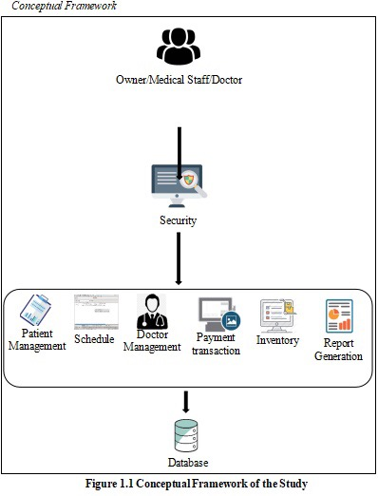
Conceptual Framework

Slide 12
Scope & Limitations
Patient Management
Doctor’s Management
Schedule
Payment Transaction
Inventory
Report Generation
Limitations
Laboratory
Notes:
The research is focused primarily on enumerating the current processes of St. Louise de Marillac;
Project limit of Patient Information System for St. Louise de Marillac is Laboratory system which are creating the result of blood type, specimen, blood sugar, diabetes, examined blood, specimen of the patient, schedule and more about Laboratory.

Slide 13
Significance of the Study
Patient
Medical Staff
Doctors
Owner
Notes:
Significance of the Study -
This is where it will be discussed the advantages of people who are a part of the system. The benefits for them are to make their workflow much faster and to avoid time-consuming due to manual processes.

Slide 14
Methodology
The method we used to this study is extreme programming and contains five phases which are the planning, designing, coding, testing and releasing.
Designing
Planning
Coding
Releasing
Testing
Figure 2. Extreme Programming

Slide 15
Methodology
We used the extreme programming method because;
for it allows developers to focus in coding
it reduces the risks related to programming and project failure.
it contributes employee satisfaction and retention.
it creates extremely simple code that can be improved at any moment
it can create software faster than the regular testing at the development stage

Slide 16
Thank you!
The next presentation is our running system.

